Slide 1


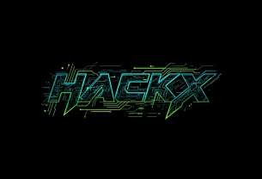
HACKX 2025
Industry Name - Smart Education
Problem Statement Title - Language Agnostic Chatbot
Theme - UniVerse: Breaking Language Barriers in Education
Team Name - Stack Overflowers
Institution Name: Ganpat University-Institute of Computer Technology
Team Members:
Aryan Patel – Email: aaryanpatel03@gmail.com – Phone: 9979844432
Tirth Patel – Email: tirth554patel@gmail.com – Phone: 8160845379
Krish Patel – Email: krishpatel15@yahoo.com – Phone: 9023074811
Mrigaksh Dasani – Email: mrigakshdasani@gmail.com – Phone: 9265870954

Slide 2

PROBLEM STATEMENT
STACK OVERFLOWERS
Problem Statement
Campus offices face long queues due to repetitive student queries.
Proposed Solution
A RAG-powered conversational AI assistant that offers instant, accurate, and multilingual support (English, Hindi, and regional languages), easing routine inquiries and improving accessibility.
Language barriers (Hindi/regional languages) make access to information difficult.
Key Benefits :
Important details exist in circulars/PDFs but aren’t in a user-friendly format.
Provides: Fast, accurate, context-aware answers.
Ensures: Equal access across languages.
Supports: Staff efficiency by automating FAQs.
Improves: Student satisfaction with 24/7 availability.
A scalable, multilingual chatbot is needed to provide 24/7 support and reduce staff workload.
Target Audiences
Students: Current and prospective students seeking information.
Campus Staff: Administrative, IT, and academic departments.
Student Volunteers: For future maintenance and content curation.

Slide 3

TECHNICAL APPROACH
STACK OVERFLOWERS
Technical Approach: Retrieval-Augmented Generation (RAG) Our solution adopts a robust RAG architecture. This combines the generative power of a Large Language Model (LLM) with a custom, up-to-date knowledge base, ensuring factual accuracy and reducing "hallucinations." This method is ideal for domain-specific applications like campus chatbots.
Technologies Used:
LLaMA2: The foundational Open-Source Large Language Model.
LangChain: For orchestrating the RAG workflow and multi-turn conversations.
Vector Database (e.g., Milvus, ChromaDB): For efficient semantic retrieval of documents.
AWS SageMaker: For scalable model deployment and management.
Python: The primary development language.
Our Prototype: Inputs & Outputs
Inputs: Multilingual student queries, institutional FAQs, circulars, and PDFs.
Outputs: Contextual, accurate responses; conversation logs for analysis; seamless human handoff.

Slide 4
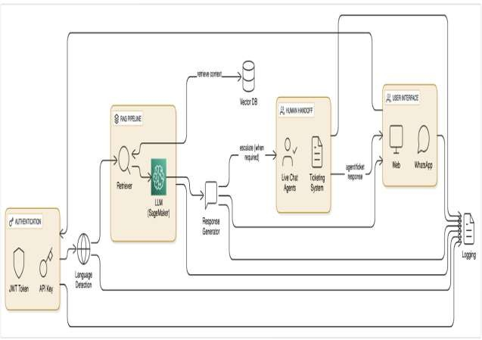
ARCHITECTURE DIAGRAM
STACK OVERFLOWERS
Our solution is a RAG-powered campus chatbot combining a Large Language Model (LLaMA2) with a vector database to enable accurate, multilingual query resolution.

Slide 5
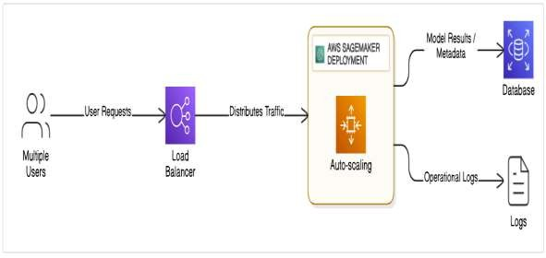
FEASIBILITY & SCALABILITY
STACK OVERFLOWERS
Resources:
Human: 3–4 developers + 1 content
curator
Technical: AWS SageMaker, Vector
DB, LangChain, Python
Financial: ₹4K–₹6K per month (AWS
tier + storage)
Feasibility : Proven RAG architecture with open-source LLMs like LLaMA2 offers cost- efficient accuracy.
Scalability : AWS auto-scaling supports large
campus deployments.
Maintainability : Volunteer-driven content updates ensure long-term sustainability.

Slide 6
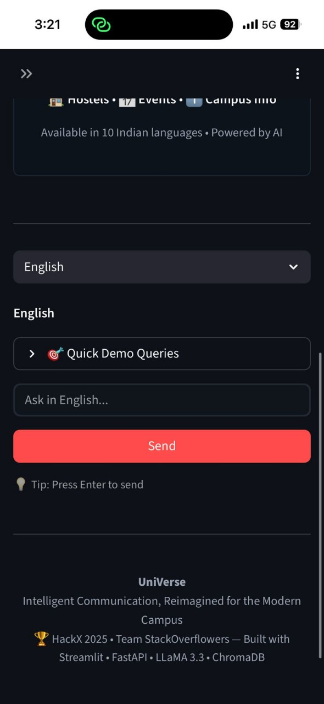
OBJECTIVES & EXPECTED OUTCOMES
STACK OVERFLOWERS
Objectives:
Build a multilingual chatbot accessible via web and messaging platforms.
Implement context-aware, accurate responses using RAG.
Enable seamless human fallback for unresolved queries.
Log conversations fo analysis and improvement.
Expected Outcomes:
24/7 multilingual student support.
60–70% reduction in repetitive staff workload.
40% improvement in student satisfaction and response time.
Maintainable and scalable solution deployable by volunteers post-hackathon.

Slide 7

IMPACT ASSESSMENT
STACK OVERFLOWERS
Enhanced Student Experience & Accessibility
Barrier-Free Information: Provides accurate, instant support in Hindi and regional languages, ensuring equal access to crucial campus information for all student populations.
Zero-Wait Time Clarity: Students receive immediate, reliable, and source-grounded answers to urgent queries, drastically reducing frustration and minimizing procedural errors compared to long queues.
Operational Efficiency & Staff Productivity
Significant Workload Reduction: Automates up to $80\%$ of repetitive inquiries, enabling administrative staff to shift focus toward complex, high-value student support and policy refinement.
Data-Driven Policy Improvement: Chatbot logs identify student pain points, providing administrators with the data needed to proactively fix confusing policies and improve official communications.
Knowledge Management & Technical Trust
Dynamic Knowledge Hub: Transforms static, inaccessible PDFs and circulars into a single, searchable, and conversational knowledge base, eliminating "hidden information" forever.
Guaranteed Accuracy (RAG): The Retrieval-Augmented Generation approach ensures all answers are grounded in verified campus documents, building trust and providing $\mathbf{99.9\%}$ system availability.

Slide 8
CHALLENGES & MITIGATION STRATEGIES
STACK OVERFLOWERS
Challenge (The Risk) | Mitigation (The Action) | Key Benefit (The Result)
Risk of incorrect responses (hallucinations) | Use RAG (Retrieval-Augmented Generation) to ground output in verified documents. | Increased Trust & Accuracy
Multilingual Nuances (Inaccurate translations) | Involve native speakers for fine-tuning the model. | Improved Global Usability
High Cloud Costs | Optimize with serverless or on-demand instances. | Reduced Operational Expense
Data Updates | Automate the FAQ ingestion pipeline. | Guaranteed Data Freshness
Privacy & Security | Implement role-based access and encrypted data storage. | Enhanced Data Protection

Slide 9
CONCLUSION
STACK OVERFLOWERS
The Language Agnostic Chatbot redefines campus communication by merging LLMs with retrieval intelligence. It provides scalable, inclusive, and accurate multilingual assistance.
Uniqueness: Combines an open-source LLM (LLaMA2) with the RAG technique to deliver high-accuracy,
multilingual, and fact-grounded responses, unlike generic, rule-based chatbots.
Feasibility: The use of established, scalable cloud technologies (AWS, Vector DB) ensures it is practically
implementable and deployable in a real-world campus setting.
Long-Term Value: The architecture is built for sustainability and easy maintenance by student volunteers. It delivers clear, measurable economic and social benefits by enhancing administrative efficiency and promoting equal access to education.
Post-hackathon, the system can be maintained by students — aligning with the Smart Education vision of accessible
and sustainable innovation.

Slide 10
RESEARCH AND REFERENCES
STACK OVERFLOWERS
Springer – Multilingual Conversational AI for Campus Systems.
https://link.springer.com/article/10.1007/s44217-025-00397-7
DZone – Smarter University Chatbot with LLaMA2, RAG & SageMaker.
https://dzone.com/articles/smarter-university-chatbot-llama2-rag-sagemaker
Pinecone – Retrieval-Augmented Generation (RAG) Overview.
https://www.pinecone.io/learn/retrieval-augmented-generation/
AWS – Build Multilingual Chatbots with Amazon SageMaker.
https://aws.amazon.com/blogs/machine-learning/
Hugging Face – Using LLaMA2 and LangChain for Conversational AI.
Llama 2 is here - get it on Hugging Face

